Slide 1
An update for San Francisco landlords, property managers, and real estate practitioners
Presented by: Daniel Bornstein, Esq.
DRE #01517095, #01517094
Questions? Email daniel@bornstein.law

Slide 2
Download presentation slides and access a wealth of additional information.
bornstein.law/resources

Slide 3
Rent due post-July 1, 2022:
Tenants cannot be evicted for nonpayment if there is a COVID-related hardship.
Expiration date:
Expires when Mayor’s pandemic emergency proclamation ends. There is no indication when this will be.
Supervisor Dean Preston proposes extending protections until 60 days after the emergency proclamation ends.
State eviction moratorium expired on July 1, 2022 but San Francisco immediately enacted its own moratorium.
We are still aggressively serving 3-day notices, but we will not know whether or not the tenant will raise a rebuttable COVID-related hardship.

Slide 4
Tenant engaging in a nuisance?
We’ll have to serve a 10-day warning letter before proceeding with a 3-day notice (Formerly for nonpayment, as well, but this was struck down by the court).
Examples: Playing loud music at night, unauthorized pets, unauthorized subletting, other breaches of the lease.
Exceptions: An imminent threat to people or property like arson, violence, drug dealing, prostitution, etc.
Bornstein Law can evaluate the severity of the conduct and advise accordingly.

Slide 5
Permissible rent increases are not keeping pace with rising operating costs.
Rent increase effective March 1, 2023 through February 29, 2024.
In order to raise rents, landlords must obtain a license that certifies compliance with the Housing Inventory program.

Slide 6
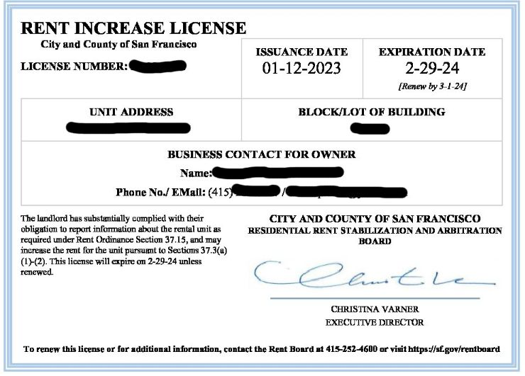

Slide 7
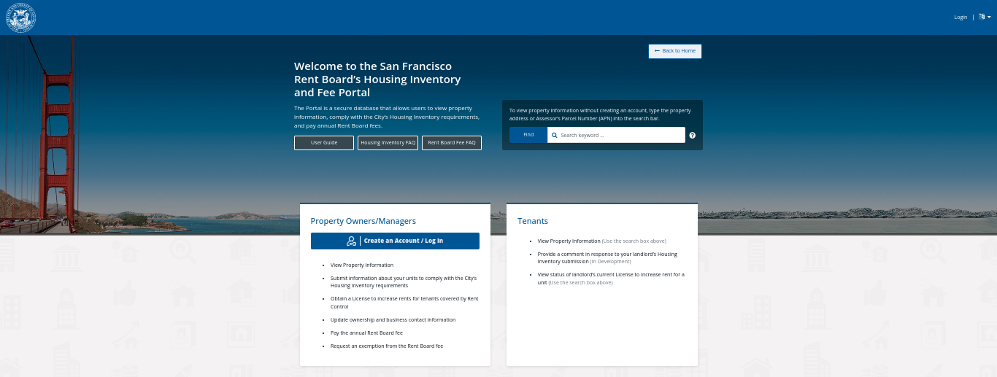
SF rent registry (“Housing Inventory”)
10+ units: required to register after July 1, 2022 with updates required every March 1 thereafter.
All other residential properties: Reporting due March 1, 2023, with an update every March.
We know there are laggards. The San Francisco’s rent board website has a wealth of information.

Slide 8
Intermediate Length Occupancy units (ILOs), also known as “corporate rentals.”
With the city besieged with short-term rentals, the Board of Supervisors enacted Ordinance No. 78-20 in April 2020, a law amending the Planning Code to create a "new residential use characteristic."

Slide 9
Beyond the new residential use characteristic, here are some highlights of the new regulatory regime:
1. Caps the number of units that can be legally used as short-term housing citywide at 1,000.
2. Armed with an ILO license, landlords are allowed to advertise and offer fixed-term tenancies for less than a year. However, it must be clear that the city’s “just cause” eviction protections apply. If the tenant elects to stay for a year, it is their prerogative; the tenant can not be forced out of the unit absent a just cause. Landlords and tenants must enter into a lease term of at least 12 months.
3. Landlords or corporate rental operators must include a disclosure on tenant rights when advertising units
4. Corporate rentals in buildings with nine units or less are permitted, as long as these hybrid units do not take up any more than 25 percent of the building's total units. Buildings with 3 or fewer dwelling units are not eligible for a license.
5. Prohibits corporate rentals in buildings with more than ten units unless a conditional use of authorization is obtained.
6. In no case can ILO's gobble up more than 20% of residential units in any one building.
7. Annual reporting requirements due no later than March 1 of each year that make it incumbent on owners or operators to share reams of information. Big Brother is watching.

Slide 10
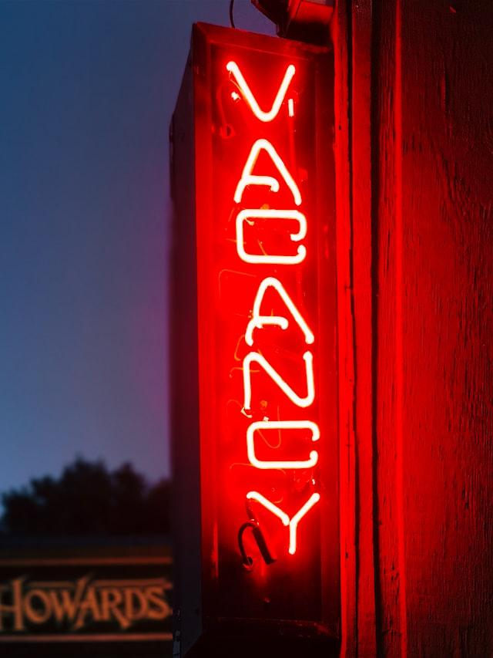
If you own something - whether a car or real estate - you should be able to use it or choose not to use it because you own it.
But not in San Francisco, where a rental property must be used for the greater public good or it will be taxed.
Properties with 3+ units vacant for 182 days in a calendar year? Taxed between $2,500 and $5,000 per unit (dependant on square footage). Increased penalties in ensuing years.
Exemptions: Single-family homes, duplexes.
More time afforded to fill vacancies in instances of repairs,, new construction, natural disaster, or death of the owner.
Current litigation challenges the ordinance, tells the city to but out.

Slide 11
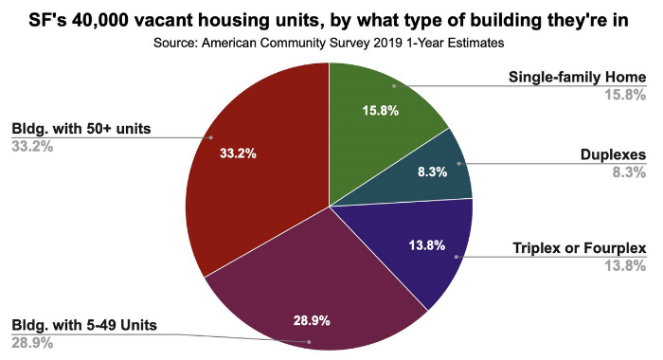
Fuzzy math? Alternative numbers estimate the number of vacant units closer to 4,000.

Slide 12
AB-1482: Regulations much more favorable than local rules.⃰
Just cause reasons to evict
15-year rolling target
Relocation payments
✱Single-family homes and condos exempt
Protections only apply when the tenant is in occupancy for 12 months. Consider a shorter-term lease to circumvent these protections.

Slide 13
Under the dome of the Capitol: New laws inked in 2022:
SB 1477: Limits the use of wage garnishment against debtors, including high-income tenants.
SB 1017: Creates additional protections for victims of domestic violence who live in rental housing.
AB 2559: With the landlord's voluntary participation, will allow reusable credit reports good for 30 days. Yet be careful of criminal background checks.
SB 971: Residents of some newly built affordable housing will be allowed to have household pets.

Slide 14
items our office needs to provide clients with a draft surrender of possession agreement, within receipt of the following information:
1. Names of Owner (s)
2. Names of Tenants and/or Occupants
3. Address of Rental Unit
4. When are the tenants vacating the unit?
5. How much are you paying them?
6. When are you going to pay them (upon signing settlement agreement or upon giving the keys to you?
7. Are the tenants going to continue to pay rent for the duration of their time in the rental unit, or is the rent waived?
8. Are you returning the security deposit according to law, or are the tenants forfeiting the security deposit?

Slide 15
Get in touch.
Tel: 415-409-7611
Email: daniel@bornstein.law
Stay in touch.
bornstein.law/subscribe
facebook.com/bornsteinlaw

