Slide 1
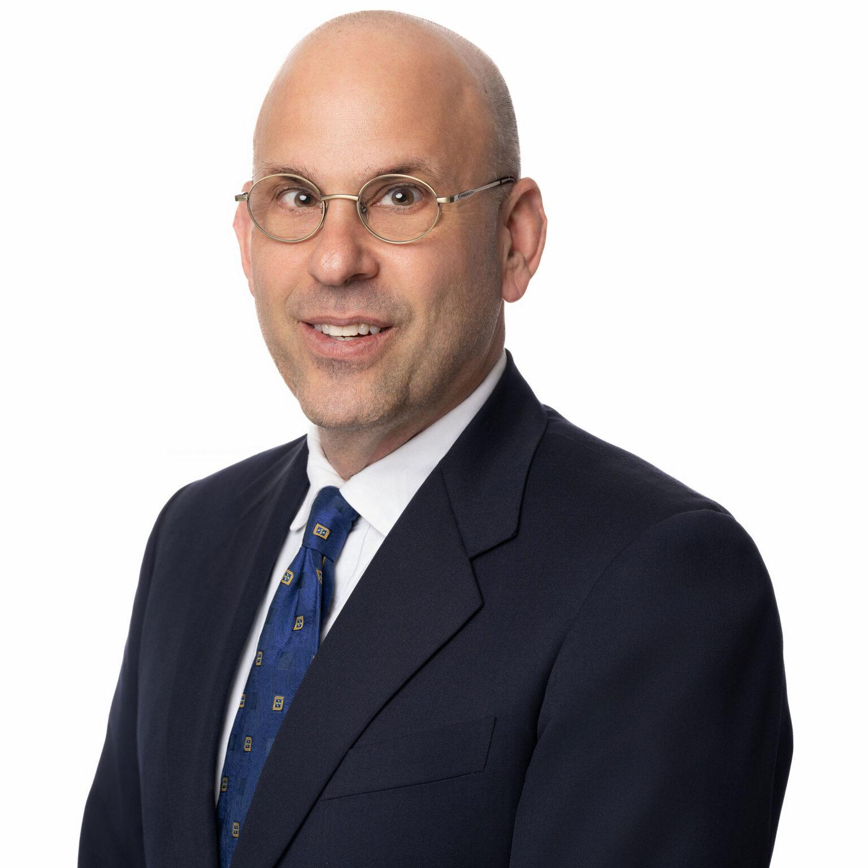
WEBINAR The best practices in property management in light of new market realities
Speaker: Daniel Bornstein, Esq.
Real estate attorney & broker of record

Slide 2
THE CHALLENGES IMPACTING HOUSING PROVIDERS ARE MANYFOLD.
Softening rents throughout the Bay Area
Escalating operating costs
Increased regulations and a proliferation of lawsuits
Finding and retaining quality tenants

Slide 3
Critical components of good property management
Excellent communication with tenants
Meticulous bookkeeping
Knowledge of the law with familiarity of state law and local ordinances that govern the rental relationship.

Slide 4
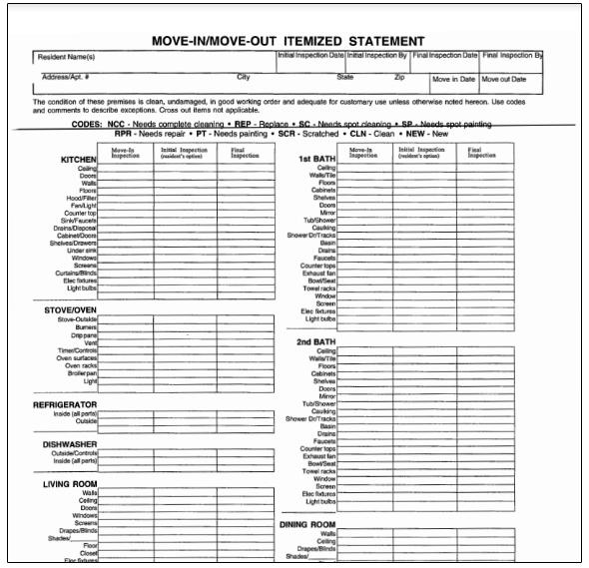
FROM THE CRADLE TO THE GRAVE
Too many housing providers view security deposit accounting as a chore to perform at the end of the rental relationship.
In fact, it begins at the inception of the tenancy with a move-in inspection.

Slide 5
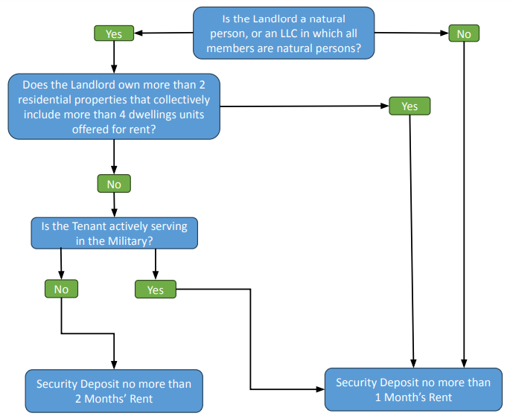

Slide 6
DO YOU KNOW YOUR ACCOUNTING SOURCES?
Monthly reports detailing all repairs, income, and expenses.
Year end statement renowned by clients and accountants alike.
Monthly payments for recurring obligations (insurance, mortgage, HOA duties, real estate taxes, etc.)
Access to custom reports, if necessary.
MAKE DATA-DRIVEN DECISIONS

Slide 7
LET’S TALK ABOUT HABITABILITY AND MAKING TIMELY REPAIRS
If you don’t check these boxes, you are inviting liability or acrimony.
Responding to repair requests in a timely fashion.
If requests are unreasonable, so indicate in writing.
Easy to submit repair requests online, through an answering service, and via email.
Using licensed and insured contractors.
Providing proper notice to effectuate repairs.
Preventative maintenance to avoid atrophy to the property.
Can the tenant reside in the unit as repairs are being made? If not, does the tenant need to be compensated for the upheaval?

Slide 8
Bay Property Group uses the most advanced technology to identify rental risks, but this is not a panacea.
Technology is paired with old-fashioned personal sleuthing to vet tenants who will be wonderful members of your rental community.
If we select a tenant that proves to be problematic, ask about our NO LEGAL FEE guarantee.
The greatest predictor of dysfunction in a rental unit is prior dysfunction and indicators of failed rental relationships in the past.

Slide 9
OFF LIMITS
In certain jurisdictions, criminal background checks of prospective tenants are prohibited.
Moreover, a new law impinges the use of credit reports when screening tenants with Section 8 vouchers or other government rent subsidies, so long as there is another verifiable source of income to pay their portion of the rent.

Slide 10
Are your leases up to date, or are you using stale, bad rental agreements downloaded from the Internet?

Slide 11
Tenants' attorneys are adept at finding mistakes in notices, leading to delay and frustration.

Slide 12
Familiarize yourself with
FAIR HOUSING LAWS
Exclusion of a certain group of tenants or expressing a preference for others is a cardinal sin that can get rental property owners sued.

Slide 13
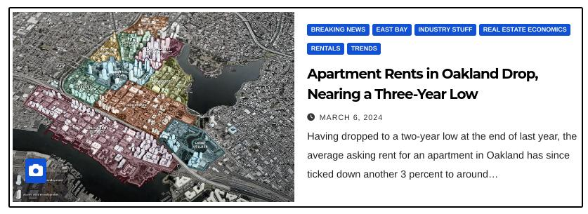
Although it’s been widely reported that Bay Area rents are slumping, prices vary by locale and by neighborhoods.
There are many intangibles to consider when right-sizing the rent.
Rather than using market comps, we draw on our experience and a variety of sources to determine rent amounts.
A common mistake is setting the rent too high, leaving a unit languishing for months.

Slide 14
Some opportunistic property management companies will attempt to exploit opportunities.
Exorbitant commissions when leases are renewed.
Upside potential when the property is listed.
You’ve worked hard to acquire your investment property. Don’t give away the store.
Are there any hidden costs in your agreement with a current property manager?
Look at the fine print.

Slide 15
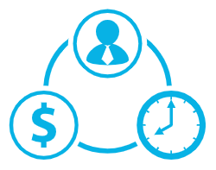
Find new tenants faster. Fill vacancies. Lower your resident acquisition costs.
Leveraging various digital tools, websites, and media, we showcase your rental units and find a motivated and qualified pool of prospective tenants.
Whether you have one door, 1,000 doors, a duplex, a triplex, a mixed-use building, or other living arrangements, Bay Property Group has the toolsets and reach to find your next resident.

Slide 16
Ensure your cash flow is steady and protected. Optimize your investment property and get tethered to the law firm built for rental property owners.
baypropertygroup.com
Email: ethan@baypropertygroup.com
Tel: 510-836-0110

